Slide 1

Crowd Simulation
Philipp Lütolf, Samuel Oberholzer
Zürich, 14.05.2014
Notes:
Samuel

Slide 2
Contents
Introduction
Our Model
Implementation
Results and Discussion
Outlook/Improvements
Questions
Notes:
samuel

Slide 3
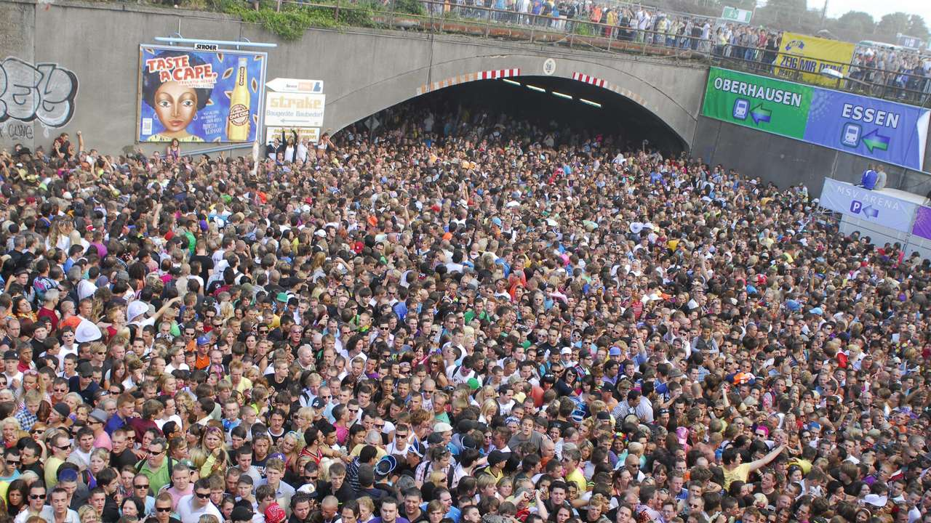
Introduction
Notes:
Philipp
Risk of crowd disaster at big events
Most recent one Love parade (picture)
Location/arrangement is a Critical factor

Slide 4
Research Questions
Where are the most critical spots for people in a crowd in a given environment?
What are the possibilities to reduce the risk to individual people by rearranging the environment?
Notes:
Philipp

Slide 5
Our Model
The Social Force Model by Helbing
Driving force
Repulsion force from other pedestrians and obstacles/walls
Attractive effects
Agent-Based
Continuous Space
Notes:
Philipp
Social force model reproduces many real life situations
Consists of Driving force, Repulsion force from other pedestrians and obstacles/walls and attractive effects
Continuous space as other projects used cellular automata

Slide 6
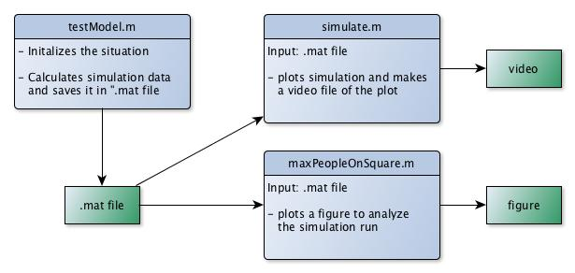
Implementation Overview
Notes:
Samuel

Slide 7
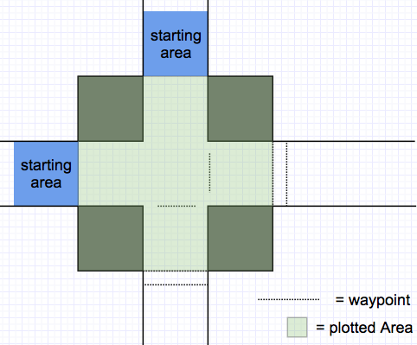
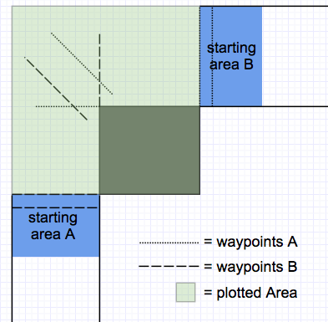
Testmodel.m - Initialization
Notes:
samuel
2 situations

Slide 8
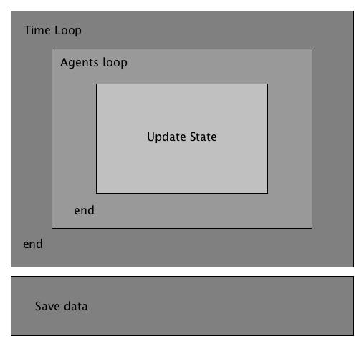
Testmodel.m - Computation
Time loop
Processing each time step
Agents loop
Processing each agent
Update
Set next destination, calculate desired direction
Compute the forces acting on the agent
Update position
Save data
Fur further analysis
Notes:
samuel

Slide 9
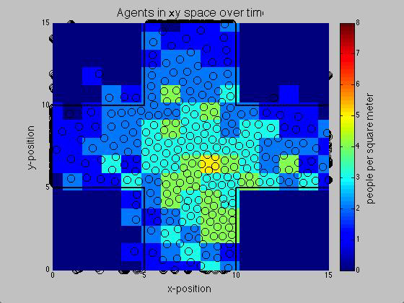
Simulate.m
Plot the simulation
Save video file
Notes:
Philipp
plotting
Agents
Walls
Ppl per square in different colors

Slide 10
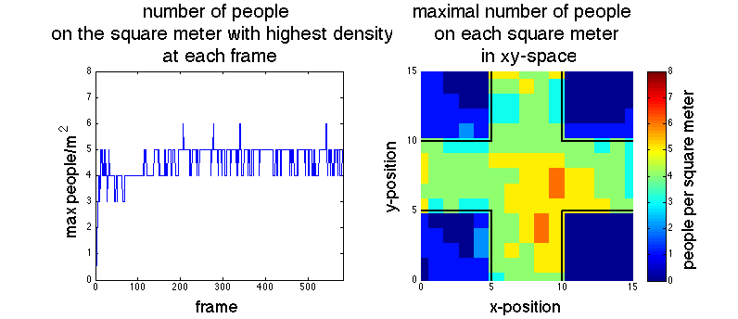
MaxPeopleOnSquare.m
Notes:
philipp
Left figure shows for every point in time the highest people per square value
Right figure shows for every square meter of the map the highest people per square value

Slide 11
Results
Number of pedestrians
200 and 300 people
Time frame
30 seconds
Obstacles
Situation
curve and cross-situation
Notes:
samuel

Slide 12
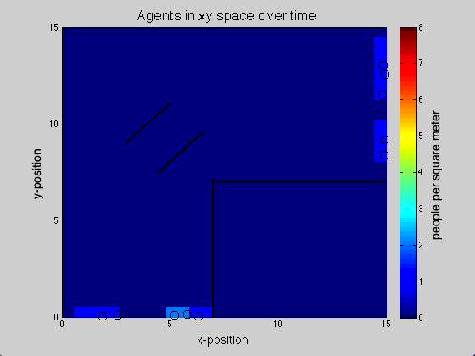
Curve-situation with 300 people and obstacles
Notes:
samuel
Lane formation
Oscillation
Density distribution
Critical spots can easily be identified

Slide 13
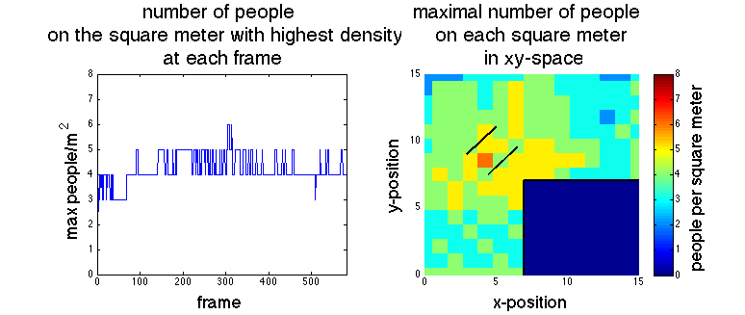
Curve-situation with 300 people and obstacles
Notes:
philipp
in most critical spots are corners, obstacles and bottlenecks
Obstacles did not reduce the risk for the pedestrians, just displaced

Slide 14
Summary
Simulation sufficient to identify the critical spots in different locations
To find obstacles which reduce the risk on pedestrians, further investigation has to be done
Notes:
philipp

Slide 15
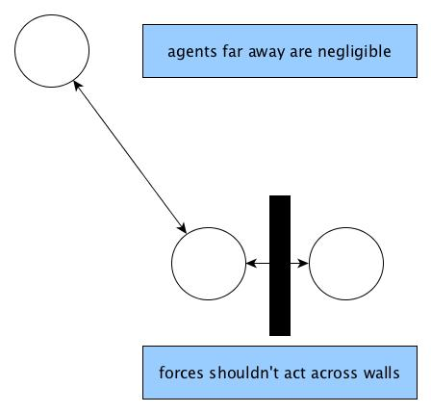
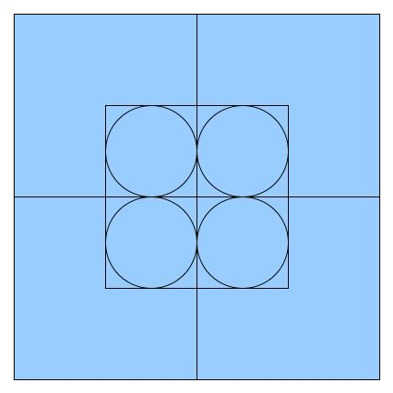
Improvements/outlook
Notes:
samuel
Agents which are far away can be neglected
Performance improvement
Forces acting on agents which are on different sides of a wall
Quality improvement
Philipp
People per square meter calculation can be optimized
Quality improvement

Slide 16
References
[1] P. M. D. Helbing, "Social force model for pedestrian dynamics," Physical Review E, vol. 51, no. 5, 1995.
[2] L. B. A. J. T. W. D. Helbing, “Self-Organized Pedestrian Crowd Dynamics: Experiments, Simulations, and Desing Solutions,” Transportation Science, vol. 39, no. 1, pp. 1-24, 2005.
[3] G. K. Still, “Crowd Risk Analysis and Crowd Safety,” [Online]. Available: http://www.gkstill.com/Support/crowd-density/CrowdDensity-1.html. [Accessed 13 May 2014].
Notes:
philipp

Slide 17

Questions
Notes:
philipp

